Slide 1



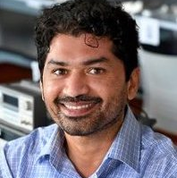



Adversarially Diversified Rehearsal Memory (ADRM): Mitigating Memory Overfitting Challenge in Continual Learning
Dr. Hikmat Khan (Presenter)
Department of Electrical and Computer Engineering,
Rowan University,
Glassboro, NJ, USA
Dr. Nidhal Carla Bouaynaya Department of Electrical and Computer Engineering,
Rowan University,
Glassboro, NJ, USA
Dr. Ghulam Rasool
Department of Machine Learning,
Moffitt Cancer Center and Research Institute,
Tampa, FL, USA
Notes:
Hello, everyone. It is an honor to present our recent work completed at Rowan University under the supervision of Dr. Nidhal and in collaboration with Dr. Ghulam Rasool.

Slide 2
Outline
Introduction | Related Work | Problem Statement | Our Work: Adversarially Diversified Rehearsal Memory| Results | Conclusions
Introduction
Related Work
Problem Statement
Our Work: Adversarially Diversified Rehearsal Memory
Results and Baselines
Evaluation Against Common Corruptions
Evaluation Against Common Adversarial Attacks
t-SNE Visualization of Latent Features Distributions in CL
Features Similarity Metrics: A Central Kernel Alignment Analysis
Visualization of CL Model’s Features in Input Space
Conclusion
Notes:
Here is the outline for today's presentation. We will begin with an introduction to the basic concepts of continual learning, followed by a review of related work and an in-depth problem statement analysis. Next, we will describe the proposed solution, the Adversarially Diversified Rehearsal Memory (ADRM), and finally, we will discuss our research findings and conclusions.

Slide 3
Outline
Introduction | Related Work | Problem Statement | Our Work: Adversarially Diversified Rehearsal Memory| Results | Conclusions
Introduction
Related Work
Problem Statement
Our Work: Adversarially Diversified Rehearsal Memory
Results and Baselines
Evaluation Against Common Corruptions
Evaluation Against Common Adversarial Attacks
t-SNE Visualization of Latent Features Distributions in CL
Features Similarity Metrics: A Central Kernel Alignment Analysis
Visualization of CL Model’s Features in Input Space
Conclusion

Slide 4
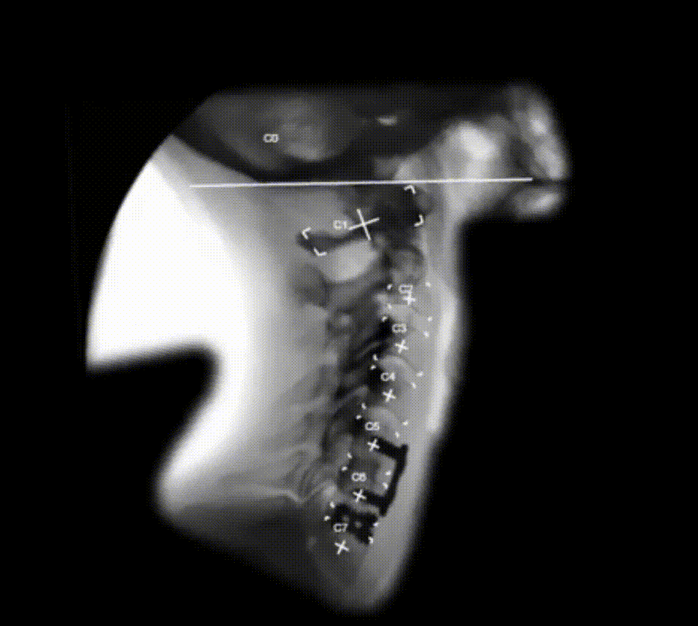
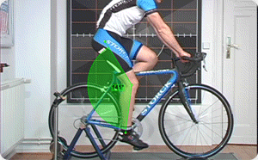
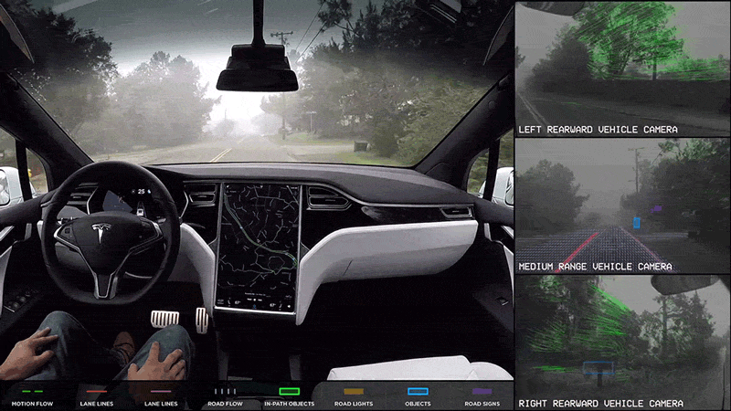
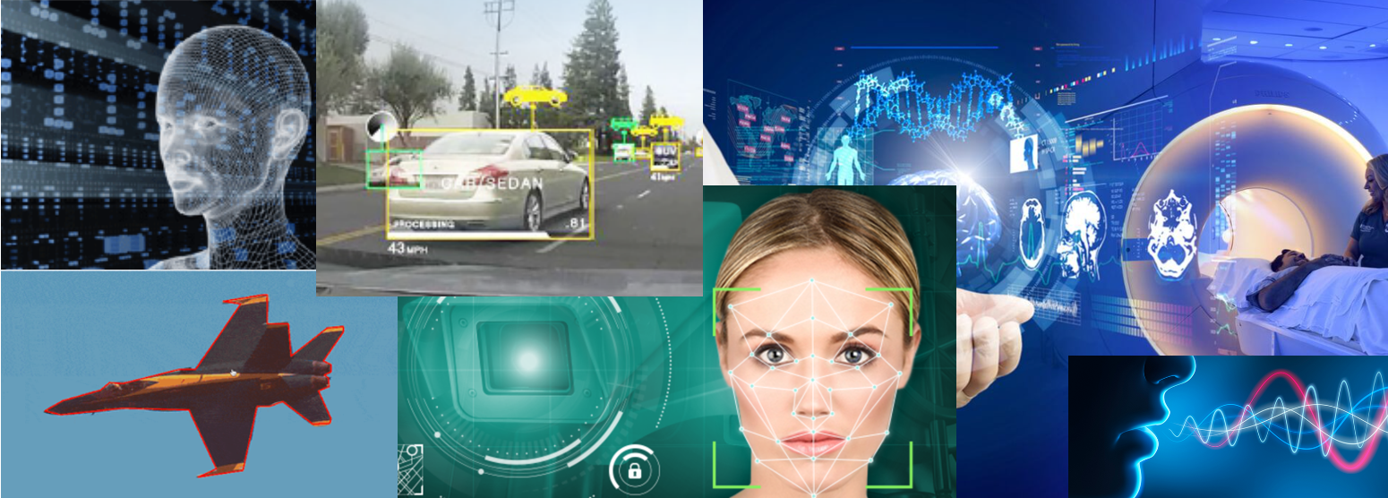
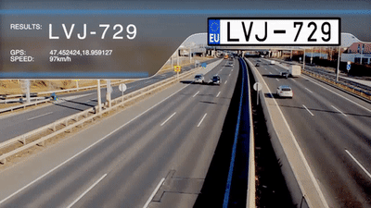
Deep Learning – The Promise
Introduction | Related Work | Problem Statement | Our Work: Adversarially Diversified Rehearsal Memory| Results | Conclusions
Deep Learning (DL)/Artificial Intelligence (AI) models have achieved or even surpassed human-level accuracy in several areas, including computer vision and pattern recognition.
Notes:
Deep Learning (DL) and Artificial Intelligence (AI) models have achieved exceptional accuracy in various fields including computer vision and pattern recognition, surpassing human-level performance. These models are trained on complete data sets and deployed to solve various problems. However, these models assume the availability of the entire dataset and a static environment that does not change over time. Unlike humans, these models cannot accumulate knowledge over time, limiting their ability to achieve the long-standing dream of AGI (Artificial General Intelligence). To address this limitation, lifelong learning, also known as continual learning, enables these models to learn sequentially over time, similar to human beings.

Slide 5
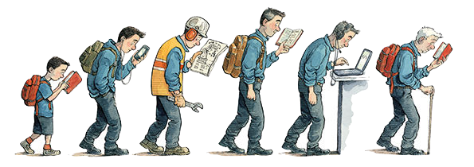
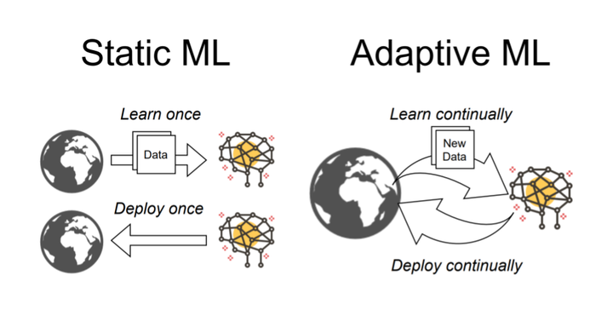
The World is Non-Stationary [5]
Introduction | Related Work | Problem Statement | Our Work: Adversarially Diversified Rehearsal Memory| Results | Conclusions
https://medium.com/gooroo-official/if-youre-not-learning-you-re-dying-b2b4d54eace4 | https://senicessm.live/product_details/47625942.html
Notes:
Deep Learning (DL) and Artificial Intelligence (AI) models have achieved exceptional accuracy in various fields including computer vision and pattern recognition, surpassing human-level performance. These models are trained on complete data sets and deployed to solve various problems. However, these models assume the availability of the entire dataset and a static environment that does not change over time. Unlike humans, these models cannot accumulate knowledge over time, limiting their ability to achieve the long-standing dream of AGI (Artificial General Intelligence). To address this limitation, lifelong learning, also known as continual learning, enables these models to learn sequentially over time, similar to human beings.

Slide 6
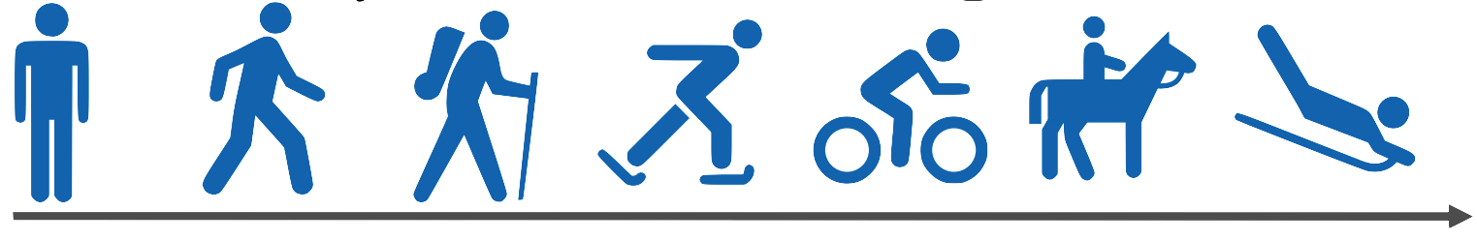

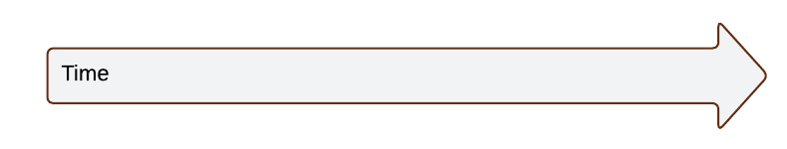
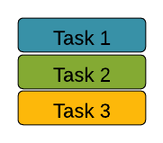
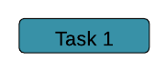
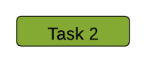

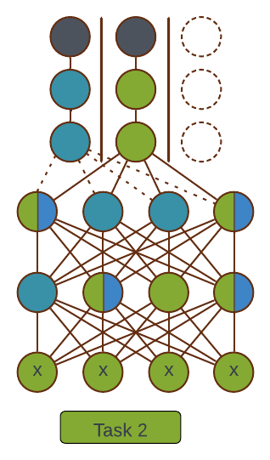
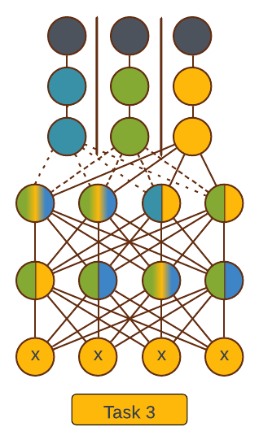
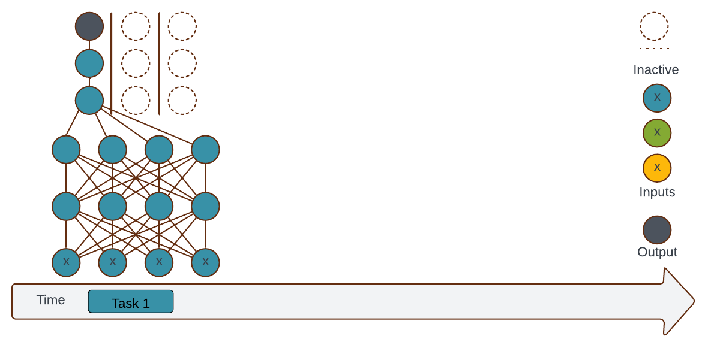
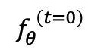
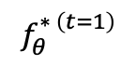
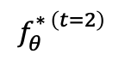
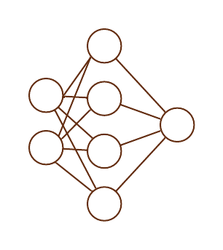
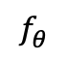
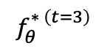
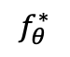
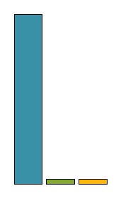
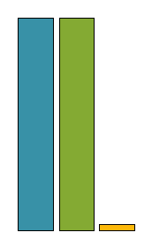
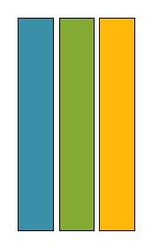
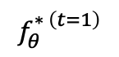
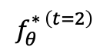
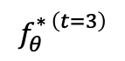
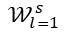
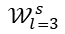
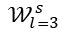
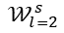
Continual Learning (CL)
Introduction | Related Work | Problem Statement | Our Work: Adversarially Diversified Rehearsal Memory| Results | Conclusions
Learning tasks over time[1].
The tasks can be any classification or segmentation.
Offline learning [1, 2].
Learn all tasks simultaneously.
time
Learn tasks
Perform tasks
Task Incremental Learning [2]
$$𝒲_{l=3}^{s}$$
$$𝒲_{l=3}^{s}$$
$$𝒲_{l=3}^{s}$$
$$𝒲_{l=2}^{s}$$
$$𝒲_{l=2}^{s}$$
$$𝒲_{l=2}^{s}$$
$$𝒲_{l=1}^{s}$$
$$𝒲_{l=1}^{s}$$
$$𝒲_{l=1}^{s}$$
Average Performance
Average Performance
Average Performance
Knowledge accumulation over time
Joint learning
Knowledge accumulation over time
Notes:
In continual learning, the model learns multiple tasks in sequential steps instead of all the tasks simultaneously through joint training. There are three different configurations for continual learning: Task Incremental Learning, Domain Incremental Learning, and Class Incremental Learning.
Task Incremental Learning
Also known as multi-head settings
Each task has its own unique set of features and output units
Task identity is required [2]
Given permutation $𝒳$, which digits?

Slide 7
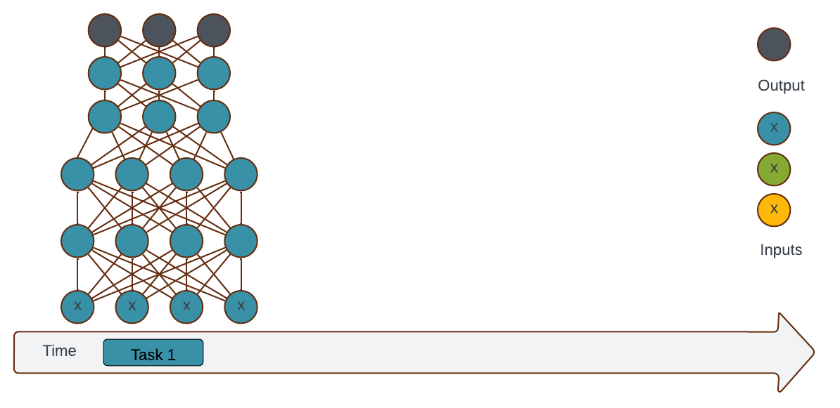
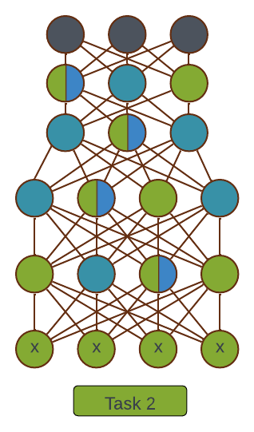
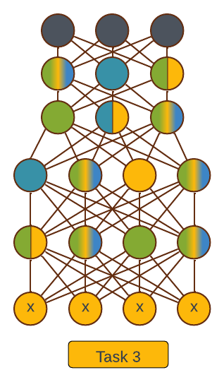
Continual Learning (CL) (Continued)
Introduction | Related Work | Problem Statement | Our Work: Adversarially Diversified Rehearsal Memory| Results | Conclusions
Learning tasks over time[1].
The tasks can be any classification or segmentation.
Offline learning [1, 2].
Learn all tasks simultaneously.
time
Learn tasks
Perform tasks
Domain Incremental Learning [2]
$$𝒲_{l=3}^{s}$$
$$𝒲_{l=3}^{s}$$
$$𝒲_{l=3}^{s}$$
$$𝒲_{l=2}^{s}$$
$$𝒲_{l=2}^{s}$$
$$𝒲_{l=2}^{s}$$
$$𝒲_{l=1}^{s}$$
$$𝒲_{l=1}^{s}$$
$$𝒲_{l=1}^{s}$$
Average Performance
Average Performance
Average Performance
Knowledge accumulation over time
Joint learning
Knowledge accumulation over time
Notes:
Domain Incremental Learning
Train on a sequence of related domains
Task identity is not required [2]
With permutation unknown, which digit?

Slide 8
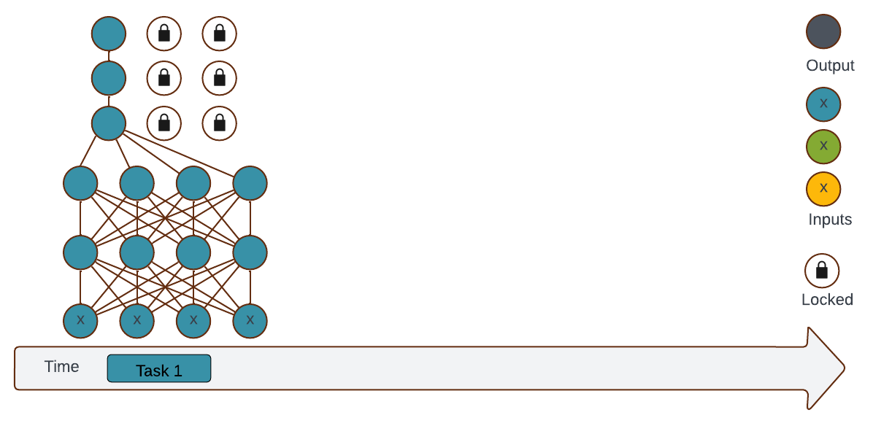
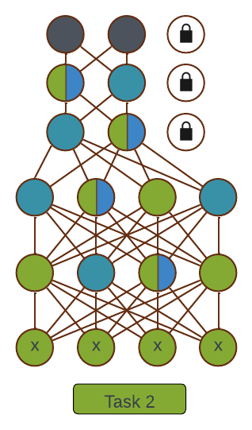
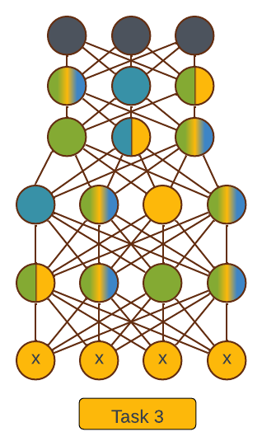
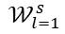
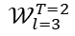
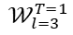
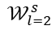
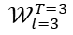
Continual Learning (CL) (Continued)
Introduction | Related Work | Problem Statement | Our Work: Adversarially Diversified Rehearsal Memory| Results | Conclusions
Learning tasks over time[1].
The tasks can be any classification or segmentation.
Offline learning [1, 2].
Learn all tasks simultaneously.
time
Learn tasks
Perform tasks
Class Incremental Learning [2]
$$𝒲_{l=3}^{T=1}$$
$$𝒲_{l=3}^{T=2}$$
$$𝒲_{l=3}^{T=3}$$
$$𝒲_{l=2}^{s}$$
$$𝒲_{l=2}^{s}$$
$$𝒲_{l=2}^{s}$$
$$𝒲_{l=1}^{s}$$
$$𝒲_{l=1}^{s}$$
$$𝒲_{l=1}^{s}$$
Average Performance
Average Performance
Average Performance
Knowledge accumulation over time
Joint learning
Knowledge accumulation over time
Notes:
Class Incremental Learning
Also, know single-head settings
Infer the task identify (No task identification required)[2]
Which digit and which permutation?

Slide 9
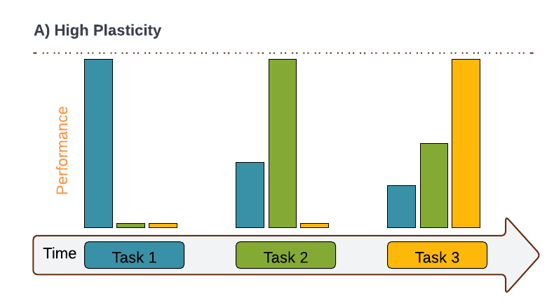
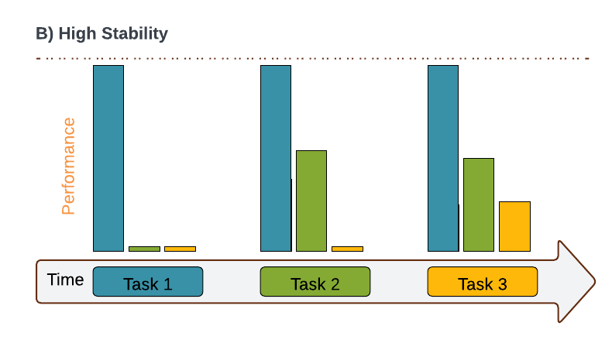
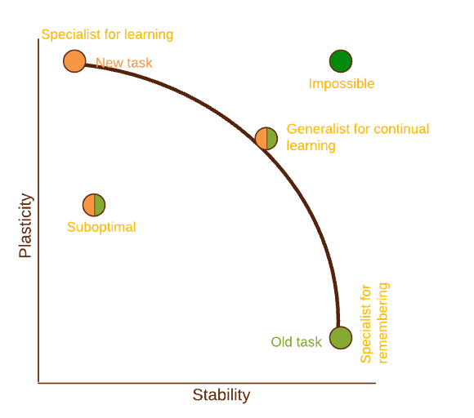
The Challenges Stopping CL
Introduction | Related Work | Problem Statement | Our Work: Adversarially Diversified Rehearsal Memory| Results | Conclusions
Plasticity-stability dilemma [3].
The plasticity-stability dilemma is a fundamental challenge in both neuroscience and deep learning design.
High Plasticity
Balance is crucial!
High stability
Notes:
The plasticity-stability dilemma is a significant challenge in neuroscience and deep learning models. It refers to the trade-off between two vital aspects: Plasticity and Stability. Plasticity is the ability of a system to learn and adapt to new experiences, while Stability is the system's ability to retain previously learned information. If a system is too plastic, it risks erasing old knowledge (a problem known as catastrophic forgetting) when new information is learned. On the other hand, if a system is too stable, it becomes flexible and capable of incorporating new knowledge effectively. Balancing these two aspects is crucial for creating models that can learn continuously and effectively over time.

Slide 10
The Challenges Stopping CL (Continued)
Introduction | Related Work | Problem Statement | Our Work: Adversarially Diversified Rehearsal Memory| Results | Conclusions
Plasticity-stability dilemma [3].
Plasticity:
Easily learn and adapt to new experiences.
Enables good adaptation.
Stability:
Ability to retain previously learned experiences.
Ensures proficiency in solving old tasks.
Catastrophic forgetting [4].
If a system is too plastic, it risks overriding old knowledge (aka catastrophic forgetting)
A phenomenon where a model forgets previously learned knowledge after acquiring new knowledge.
Notes:
Plasticity-stability dilemma
The plasticity-stability dilemma is a fundamental challenge in both neuroscience and deep learning design
It refers to the trade-off between
Plasticity—the ability of a system to learn and adapt to new experiences.
Stability, which is the system's ability to retain previously learned information.
If a system is too plastic, it risks overriding old knowledge (a problem known as catastrophic forgetting) when new information is learned.
Conversely, if a system is too stable, it becomes rigid and unable to incorporate new knowledge effectively.
Balancing these two aspects is crucial for creating models that can learn continuously and effectively over time.

Slide 11
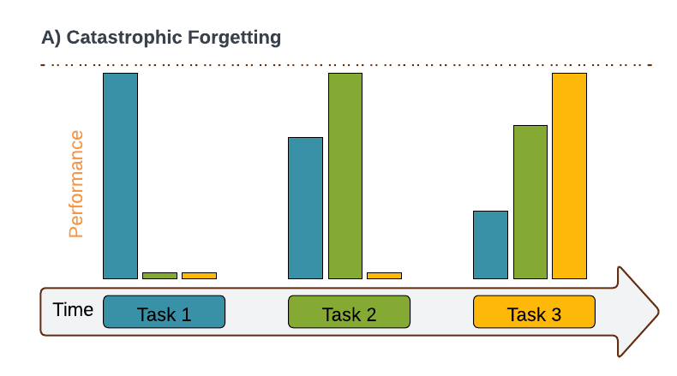
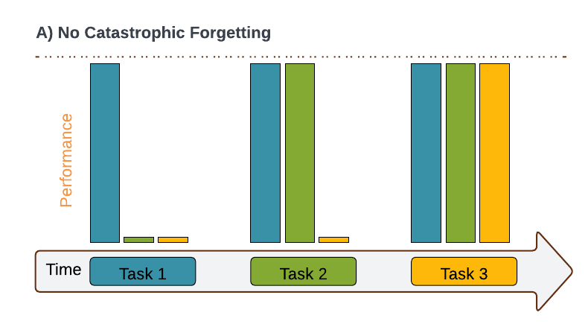
The Challenges Stopping CL (Continued)
Introduction | Related Work | Problem Statement | Our Work: Adversarially Diversified Rehearsal Memory| Results | Conclusions
Plasticity-stability dilemma [3].
Plasticity:
Easily learn and adapt to new experiences.
Enables good adaptation.
Stability:
Ability to retain previously learned experiences.
Ensures proficiency in solving old tasks.
Catastrophic forgetting [4].
High Plasticity
Ideal
Balance is crucial!
High Plasticity
High Stability
Balance is crucial!
High Plasticity
Balance is Crucial!
Ideal
High stability
Notes:
Balancing these two aspects is crucial for creating models that can learn continuously and effectively over time.

Slide 12
Outline
Introduction| Related Work | Problem Statement | Our Work: Adversarially Diversified Rehearsal Memory| Results | Conclusions
Introduction
Related Work
Problem Statement
Our Work: Adversarially Diversified Rehearsal Memory
Results and Baselines
Evaluation Against Common Corruptions
Evaluation Against Common Adversarial Attacks
t-SNE Visualization of Latent Features Distributions in CL
Features Similarity Metrics: A Central Kernel Alignment Analysis
Visualization of CL Model’s Features in Input Space
Conclusion
Notes:
Adversarial Examples are not Bugs, They are Features

Slide 13
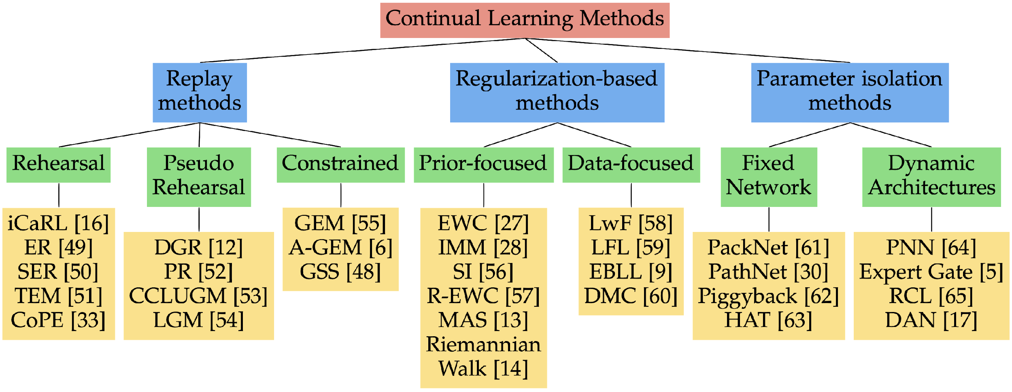
Related Work
Introduction| Related Work | Problem Statement | Our Work: Adversarially Diversified Rehearsal Memory| Results | Conclusions
Rehearsal-based Approaches [1, 5]
Store a subset of the old data and rehearse it during
the learning of the subsequent tasks.
Regularization-based Approaches [1, 5]
Penalize (important) parameter updates.
Architectural-based Approaches [1, 5]
Increase the model capacity for every new task.
Explicitly identify important parameters for each task.
Knowledge Distillation-based Approaches [1, 5]
Take inspiration from the Knowledge Distillation.
Use the previous task model as a teacher.
Dataset Distillation-based Approaches [1, 5]
Create representative subsets that can be rehearsed during the learning of the subsequent tasks.
Brain-inspired Approaches [1, 5]
Incorporate inspiration from neuroscience in designing the CL
Hybrid Approaches [1, 5]
Combine multiple approaches to create more robust solutions against catastrophic forgetting.
Taxonomy of CL approaches [1]

Slide 14
Outline
Introduction| Related Work | Problem Statement | Our Work: Adversarially Diversified Rehearsal Memory| Results | Conclusions
Introduction
Related Work
Problem Statement
Our Work: Adversarially Diversified Rehearsal Memory
Results and Baselines
Evaluation Against Common Corruptions
Evaluation Against Common Adversarial Attacks
t-SNE Visualization of Latent Features Distributions in CL
Features Similarity Metrics: A Central Kernel Alignment Analysis
Visualization of CL Model’s Features in Input Space
Conclusion
Notes:
Adversarial Examples are not Bugs, They are Features

Slide 15
Problem Statement
Introduction| Related Work | Problem Statement | Our Work: Adversarially Diversified Rehearsal Memory| Results | Conclusions
Rehearsal-based approaches are widely adopted to mitigate catastrophic forgetting in CL models.
However, these approaches suffer from rehearsal memory overfitting, where the CL model becomes overly specialized on a limited set of memory samples, resulting in catastrophic forgetting.
Leading to a progressive decay in the effectiveness of the rehearsal memory, ultimately causing the model to forget previously learned tasks.
Question!
Can rehearsal memory be diversified to prevent rehearsal memory overfitting in the CL model?

Slide 16
Outline
Introduction| Related Work | Problem Statement| Our Work: Adversarially Diversified Rehearsal Memory | Results | Conclusions
Introduction
Related Work
Problem Statement
Our Work: Adversarially Diversified Rehearsal Memory
Results and Baselines
Evaluation Against Common Corruptions
Evaluation Against Common Adversarial Attacks
t-SNE Visualization of Latent Features Distributions in CL
Features Similarity Metrics: A Central Kernel Alignment Analysis
Visualization of CL Model’s Features in Input Space
Conclusion
Notes:
Adversarial Examples are not Bugs, They are Features

Slide 17


Introduction| Related Work | Problem Statement| Our Work: Adversarially Diversified Rehearsal Memory | Results | Conclusions
Adversarial Attacks (Quick Refresher)
Fast Gradient Sign Method (FGSM) [10]
$$x_{adv}=x+ε∗sign(Δ_{x} J\left(θ, x, y\right))$$

Slide 18






Idea Illustration: Adversarially Diversified Rehearsal Memory
Introduction| Related Work | Problem Statement| Our Work: Adversarially Diversified Rehearsal Memory | Results | Conclusions
Ideal
Overlapping
Shifts
Stable & No-Shifts

Slide 19















Idea Illustration: Adversarially Diversified Rehearsal Memory
Introduction| Related Work | Problem Statement| Our Work: Adversarially Diversified Rehearsal Memory | Results | Conclusions
$$ε=\frac{12}{255}$$
$$ε=\frac{9}{255}$$
Original airplane samples
Airplane
samples
Correctly classified adversarially diversified airplane samples
$$ε=\frac{2}{255}$$
$$ε=\frac{16}{255}$$
$$ε=\frac{5}{255}$$
Incorrectly classified adversarially diversified airplane samples
t-SNE visualization showing the dispersion of 'airplane' class features under increasing adversarial perturbations
Notes:
Key Benefits of Adversarially Diversified Rehearsal Memory (ADRM):
Combats Overfitting: Introduces a wider range of challenges within rehearsal samples, reducing the model's likelihood of over-specializing.
Sustains Rehearsal Effectiveness: Keeps rehearsal memory dynamically challenging, encouraging better generalization across tasks.
Facilitates Seamless New Task Learning: Supports the model's ability to assimilate new tasks without sacrificing performance on old tasks, crucial for effective continual learning.

Slide 20






Adversarially Diversified Rehearsal Memory (ADRM)
Introduction| Related Work | Problem Statement| Our Work: Adversarially Diversified Rehearsal Memory | Results | Conclusions
Rehearsal-Based Continual Learning
$$\min_{θ∈Θ}\left[𝔼_{\left(x_{t}, y_{t}\right)\sim 𝒟_{t}}ℒ\left(θ, x_{t}, y_{t}\right)+𝔼_{\left(x_{m}, y_{m}\right)\sim ℳ_{t}}ℒ\left(θ, x_{m}, y_{m}\right)\right]$$
Aims to increase the complexity of memory samples using FGSM [10]
$x_{diversified}=x_{m}+ε . sign(∇_{x_{m}} J(θ, x_{m}, y_{m})$)
Benefits of ADRM:
Prevents rehearsal memory overfitting.
Maintains the effectiveness of rehearsal memory samples.
Enables CL models to learn new tasks without performance degradation.
Current task
Memory
Airplane samples
$$ε=\frac{2}{255}$$
$$ε=\frac{5}{255}$$
$$ε=\frac{9}{255}$$
$$ε=\frac{12}{255}$$
$$ε=\frac{16}{255}$$
Notes:
Benefits of Adversarially Diversified Rehearsal Memory (ADRM):
Prevents rehearsal memory overfitting:
By introducing diversity in rehearsal samples, it mitigates the risk of the model becoming overly specialized on a narrow set of samples.
Maintains the effectiveness of rehearsal memory samples:
Ensures that rehearsal samples remain representative and challenging, promoting better generalization.
Enables CL models to learn new tasks without performance degradation:
Facilitates the acquisition of new knowledge while preserving previously learned information, thus maintaining high performance across tasks.

Slide 21
Outline
Introduction| Related Work | Problem Statement|Our Work: Adversarially Diversified Rehearsal Memory| Results | Conclusions
Introduction
Related Work
Problem Statement
Our Work: Adversarially Diversified Rehearsal Memory
Results and Baselines
Evaluation Against Common Corruptions
Evaluation Against Common Adversarial Attacks
t-SNE Visualization of Latent Features Distributions in CL
Features Similarity Metrics: A Central Kernel Alignment Analysis
Visualization of CL Model’s Features in Input Space
Conclusion
Notes:
Adversarial Examples are not Bugs, They are Features

Slide 22





Results and Baselines
Introduction| Related Work | Problem Statement|Our Work: Adversarially Diversified Rehearsal Memory| Results | Conclusions
The ADRM outperforms several established CL approaches and achieves comparable results to state-of-the-art CL approaches.
ADRM, when rehearsed with $10\%$adversarially diversified memory, demonstrates superior performance over variants incorporating $25\%$, $50\%, 75\%$, and $100\%$ diversified memory.
The $10\%$adversarially diversified memory suggests that a minimal level of adversarial diversification, can prevent the rehearsal memory overfitting in CL.
Generalization
Trade-off [38]
$$9.37\%$$
$$4.38\%$$
$$1.09\%$$
Robustness
High
Number of tasks
Low
Comparative performance of CL methods on the Split-CIFAR10 dataset over 9 steps, 5 steps, and 2 steps.
Notes:
!! baselines

Slide 23
Outline
Introduction| Related Work | Problem Statement|Our Work: Adversarially Diversified Rehearsal Memory| Results| Conclusions
Introduction
Related Work
Problem Statement
Our Work: Adversarially Diversified Rehearsal Memory
Results and Baselines
Evaluation Against Common Corruptions
Evaluation Against Common Adversarial Attacks
t-SNE Visualization of Latent Features Distributions in CL
Features Similarity Metrics: A Central Kernel Alignment Analysis
Visualization of CL Model’s Features in Input Space
Conclusion
Notes:
Adversarial Examples are not Bugs, They are Features

Slide 24

CIFAR10-C (Corrupted) Dataset
Introduction| Related Work | Problem Statement|Our Work: Adversarially Diversified Rehearsal Memory| Results: Contribution# 2 | Conclusions
The CIFAR10-C dataset is a variant of the original CIFAR10 dataset, characterized by the inclusion of corrupted images designed to challenge and evaluate the robustness of models [21].
Corrupted images are generated by applying nineteen different types of corruption, such as brightness, fog, and others.
We used the CIFAR-10-C dataset to evaluate the robustness and catastrophic forgetting for all benchmark CL models.
Notes:
CIFAR10-C is the corrupted version of the CIFAR10 dataset, which is used to evaluate the robustness of the models against different types of corruption
To better understand the role of the features in input and the forgetting in the CL models, we used CIFAR10-C to access the forgetting of the five CL models under these different types of corruptions.

Slide 25




Evaluating Against Common Corruptions
Introduction| Related Work | Problem Statement|Our Work: Adversarially Diversified Rehearsal Memory| Results | Conclusions
CIFAR10-C (Corrupted) is a variant of the original CIFAR10 dataset that contains corrupted images [6, 21].
The ADRM model performed relatively best (in 15 out of 19 cases) in various noisy conditions.
Defocus blur
Glass blur
Elastic transform
Gaussian noise
Jpeg compression
Motion blur

Slide 26
Outline
Introduction| Related Work | Problem Statement|Our Work: Adversarially Diversified Rehearsal Memory| Results | Conclusions
Introduction
Related Work
Problem Statement
Our Work: Adversarially Diversified Rehearsal Memory
Results and Baselines
Evaluation Against Common Corruptions
Evaluation Against Common Adversarial Attacks
t-SNE Visualization of Latent Features Distributions in CL
Features Similarity Metrics: A Central Kernel Alignment Analysis
Visualization of CL Model’s Features in Input Space
Conclusion
Notes:
Adversarial Examples are not Bugs, They are Features

Slide 27


Evaluating Against Adversarial Attacks
Introduction| Related Work | Problem Statement|Our Work: Adversarially Diversified Rehearsal Memory| Results | Conclusions
All ADRM variants experienced less catastrophic forgetting in adversarial conditions.
FGSM [10]: $\frac{1}{255}≤ε≤\frac{244}{255}$

Slide 28
Outline
Introduction| Related Work | Problem Statement|Our Work: Adversarially Diversified Rehearsal Memory| Results | Conclusions
Introduction
Related Work
Problem Statement
Our Work: Adversarially Diversified Rehearsal Memory
Results and Baselines
Evaluation Against Common Corruptions
Evaluation Against Common Adversarial Attacks
t-SNE Visualization of Latent Features Distributions in CL
Features Similarity Metrics: A Central Kernel Alignment Analysis
Visualization of CL Model’s Features in Input Space
Conclusion
Notes:
Adversarial Examples are not Bugs, They are Features

Slide 29

t-SNE Visualization of Latent Feature Distributions in CL
Introduction| Related Work | Problem Statement|Our Work: Adversarially Diversified Rehearsal Memory| Results | Conclusions
We utilized t-SNE to visualize the distributions of latent features at the logit layer of the CL models [23] using adversarially perturbed CIFAR10 dataset [6].
Class-Incremental data stream
High
Overlapping
Distributional
shift
Distributional
shift

Slide 30

t-SNE Visualization of Latent Feature Distributions in CL (Continued)
Introduction| Related Work | Problem Statement|Our Work: Adversarially Diversified Rehearsal Memory| Results | Conclusions
Visualization of the learned latent feature distributions for airplanes and automobiles (from the adversarially perturbed CIFAR10 dataset [6]) at the logit layer of CL models [23].
Stable Distributions with Minimum Drifts
High overlapping
Distributional
shift
High overlapping
ADRM
Experience Replay [6]
PODNet [34]
MEMO [38]

Slide 31
Outline
Introduction| Related Work | Problem Statement|Our Work: Adversarially Diversified Rehearsal Memory| Results | Conclusions
Introduction
Related Work
Problem Statement
Our Work: Adversarially Diversified Rehearsal Memory
Results and Baselines
Evaluation Against Common Corruptions
Evaluation Against Common Adversarial Attacks
t-SNE Visualization of Latent Features Distributions in CL
Features Similarity Metrics: A Central Kernel Alignment Analysis
Visualization of CL Model’s Features in Input Space
Conclusion
Notes:
Adversarial Examples are not Bugs, They are Features

Slide 32


Features Similarity Matrices: A Central Kernel Alignment Analysis [24]
Introduction| Related Work | Problem Statement|Our Work: Adversarially Diversified Rehearsal Memory| Results | Conclusions
The CL models displayed higher feature similarities (Central Kernel Alignment [24]) to ADRM on Standard CIFAR10 but differed in feature similarities on adversarially perturbed CIFAR10 [6].
a) Feature Similarity on Standard CIFAR10
b) Feature Similarity on adversarial perturbed CIFAR10

Slide 33
Features Similarity Matrices: A Central Kernel Alignment Analysis [24]
Introduction| Related Work | Problem Statement|Our Work: Adversarially Diversified Rehearsal Memory| Results | Conclusions
The CL models displayed higher feature similarities (Central Kernel Alignment [24]) to ADRM on Standard CIFAR10 but differed in feature similarities on adversarially perturbed CIFAR10 [6].
Comparative performance of CL methods on the Split-CIFAR10 dataset over 9 steps, 5 steps, and 2 steps.
a) Feature Similarity on Standard CIFAR10

Slide 34
Features Similarity Matrices: A Central Kernel Alignment Analysis [24]
Introduction| Related Work | Problem Statement|Our Work: Adversarially Diversified Rehearsal Memory| Results | Conclusions
The CL models displayed higher feature similarities (Central Kernel Alignment [24]) to ADRM on Standard CIFAR10 but differed in feature similarities on adversarially perturbed CIFAR10 [6].
ADRM
PodNet
WA
iCaRL
MEMO
b) Feature Similarity on adversarial perturbed CIFAR10

Slide 35
Outline
Introduction| Related Work | Problem Statement|Our Work: Adversarially Diversified Rehearsal Memory| Results | Conclusions
Introduction
Related Work
Problem Statement
Our Work: Adversarially Diversified Rehearsal Memory
Results and Baselines
Evaluation Against Common Corruptions
Evaluation Against Common Adversarial Attacks
t-SNE Visualization of Latent Features Distributions in CL
Features Similarity Metrics: A Central Kernel Alignment Analysis
Visualization of CL Model’s Features in Input Space
Conclusion
Notes:
Adversarial Examples are not Bugs, They are Features

Slide 36





Visualization of CL Models' Features for Automobile (Car) Class in Input Space
Introduction| Related Work | Problem Statement|Our Work: Adversarially Diversified Rehearsal Memory| Results | Conclusions
The features visualization for the CL model$f_{θ_{t}}^{∗}$ is performed by solving the below:
$$\min_{x_{r}}∥f_{θ_{t}}^{∗}\left(x_{r}\right)−f_{θ_{t}}^{∗}\left(x\right)∥_{2}^{2}, { x}_{r}\sim D$$
ADRM learned the salient features of the object as compared to the others CL models.
ADRM
Experience Replay [6]
PODNet [34]
MEMO [38]
a) Visualization of disentangled features for car class in input space

Slide 37
Outline
Introduction| Related Work | Problem Statement|Our Work: Adversarially Diversified Rehearsal Memory|Results | Conclusions
Introduction
Related Work
Problem Statement
Our Work: Adversarially Diversified Rehearsal Memory
Results and Baselines
Evaluation Against Common Corruptions
Evaluation Against Common Adversarial Attacks
t-SNE Visualization of Latent Features Distributions in CL
Features Similarity Metrics: A Central Kernel Alignment Analysis
Visualization of CL Model’s Features in Input Space
Conclusion
Notes:
Adversarial Examples are not Bugs, They are Features

Slide 38
Conclusions
Introduction | Related Work | Research Questions | Our Work: A Multidisciplinary Approach | Primary Contributions | Conclusions
Rehearsal memory can be diversified to prevent rehearsal memory overfitting in the CL models.
Rehearsal memory diversification increases the complexity of the memory samples and prevents memory overfitting,
Resulting in:
Maintaining the effectiveness of memory samples throughout learning
Reduced catastrophic forgetting
Our Code is publicly available at https://github.com/hikmatkhan/ADRM

Slide 39
Acknowledgment
Introduction | Related Work | Research Questions | Our Work: A Multidisciplinary Approach | Primary Contributions | Conclusions | Acknowledgments
This work was supported by National Science Foundation (NSF) Award NSF OAC 2008690.

Slide 40
References
Introduction | Related Work | Research Questions | Our Work: A Multidisciplinary Approach | Primary Contributions | Conclusions | References
[1]. De Lange, Matthias, Rahaf Aljundi, Marc Masana, Sarah Parisot, Xu Jia, Aleš Leonardis, Gregory Slabaugh, and Tinne Tuytelaars. "A continual learning survey: Defying forgetting in classification tasks." IEEE transactions on pattern analysis and machine intelligence 44, no. 7 (2021): 3366-3385.
[2]. Van de Ven, Gido M., and Andreas S. Tolias. "Three scenarios for continual learning." arXiv preprint arXiv:1904.07734 (2019).
[3]. Mermillod, Martial, Aurélia Bugaiska, and Patrick Bonin. "The stability-plasticity dilemma: Investigating the continuum from catastrophic forgetting to age-limited learning effects." Frontiers in psychology 4 (2013): 504.
[4]. French, Robert M. "Catastrophic forgetting in connectionist networks." Trends in cognitive sciences 3, no. 4 (1999): 128-135.
[5]. Wang, Liyuan, Xingxing Zhang, Hang Su, and Jun Zhu. "A comprehensive survey of continual learning: Theory, method and application." IEEE Transactions on Pattern Analysis and Machine Intelligence (2024).
[6]. H. Khan, N. C. Bouaynaya and G. Rasool, "Adversarially Robust Continual Learning," 2022 International Joint Conference on Neural Networks (IJCNN), Padua, Italy, 2022, pp. 1-8, doi: 10.1109/IJCNN55064.2022.9892970. doi: 10.1109/ISCC58397.2023.10218203.
[7]. H. Khan, N. C. Bouaynaya and G. Rasool, "The Importance of Robust Features in Mitigating Catastrophic Forgetting," in 2023 IEEE Symposium on Computers and Communications (ISCC), Gammarth, Tunisia, 2023 pp. 752-757.
[8]. H. Khan, N. C. Bouaynaya and G. Rasool, "Brain-Inspired Continual Learning: Robust Feature Distillation and Re-Consolidation for Class Incremental Learning," in IEEE Access, vol. 12, pp. 34054-34073, 2024, doi: 10.1109/ACCESS.2024.33694.88.
[9]. H. Khan, N. C. Bouaynaya and G. Rasool, "Adversarially Diversified Rehearsal Memory (ADRM): Mitigating Memory Overfitting Challenge in Continual Learning," 2024 International Joint Conference on Neural Networks (IJCNN), Yokohama, Japan, 2024, pp. 1-8.
[10]. Goodfellow, Ian J., Jonathon Shlens, and Christian Szegedy. "Explaining and harnessing adversarial examples." arXiv preprint arXiv:1412.6572 (2014).
[11]. Ilyas, Andrew, Shibani Santurkar, Dimitris Tsipras, Logan Engstrom, Brandon Tran, and Aleksander Madry. "Adversarial examples are not bugs, they are features." Advances in neural information processing systems 32 (2019).
[12]. Wang, Tongzhou, Jun-Yan Zhu, Antonio Torralba, and Alexei A. Efros. "Dataset distillation." arXiv preprint arXiv:1811.10959 (2018).
[13]. Kim, Jang-Hyun, Jinuk Kim, Seong Joon Oh, Sangdoo Yun, Hwanjun Song, Joonhyun Jeong, Jung-Woo Ha, and Hyun Oh Song. "Dataset condensation via efficient synthetic-data parameterization." In International Conference on Machine Learning, pp. 11102-11118. PMLR, 2022.
[14]. Deng, Zhiwei, and Olga Russakovsky. "Remember the past: Distilling datasets into addressable memories for neural networks." Advances in Neural Information Processing Systems 35 (2022): 34391-34404.

Slide 41
References (Continued)
Introduction | Related Work | Research Questions | Our Work: A Multidisciplinary Approach | Primary Contributions | Conclusions | References
[15]. Rolnick, David, Arun Ahuja, Jonathan Schwarz, Timothy Lillicrap, and Gregory Wayne. "Experience replay for continual learning." Advances in neural information processing systems 32 (2019).
[16]. Kirkpatrick, James, Razvan Pascanu, Neil Rabinowitz, Joel Veness, Guillaume Desjardins, Andrei A. Rusu, Kieran Milan et al. "Overcoming catastrophic forgetting in neural networks." Proceedings of the national academy of sciences 114, no. 13 (2017): 3521-3526.
[17]. Yan, Shipeng, Jiangwei Xie, and Xuming He. "Der: Dynamically expandable representation for class incremental learning." In Proceedings of the IEEE/CVF conference on computer vision and pattern recognition, pp. 3014-3023. 2021.
[18]. Douillard, Arthur, Matthieu Cord, Charles Ollion, Thomas Robert, and Eduardo Valle. "Podnet: Pooled outputs distillation for small-tasks incremental learning." In Computer vision–ECCV 2020: 16th European conference, Glasgow, UK, August 23–28, 2020, proceedings, part XX 16, pp. 86-102. Springer International Publishing, 2020.
[19]. H. Khan, C. Johnson, R. University, N. Bouaynaya, G. Rasool, T. Travis, et al., "Explainable AI: Rotorcraft attitude prediction", Proc. Vertical Flight Soc. 76th Annu. Forum, Oct. 2020.
[20]. H. Khan, C. Johnson, R. University, N. Bouaynaya, G. Rasool, L. Thompson, et al., "Deep ensemble for rotorcraft attitude prediction", Proc. Vertical Flight Soc. 77th Annu. Forum, May 2021.
[21]. Hendrycks, Dan, and Thomas Dietterich. "Benchmarking neural network robustness to common corruptions and perturbations." arXiv preprint arXiv:1903.12261 (2019).
[22]. Van der Maaten, Laurens, and Geoffrey Hinton. "Visualizing data using t-SNE." Journal of machine learning research 9, no. 11 (2008).
[23]. Van der Maaten, Laurens, and Geoffrey Hinton. "Visualizing data using t-SNE." Journal of machine learning research 9, no. 11 (2008).
[24]. Kornblith, Simon, Mohammad Norouzi, Honglak Lee, and Geoffrey Hinton. "Similarity of neural network representations revisited." In International conference on machine learning, pp. 3519-3529. PMLR, 2019.
[25]. Zhao, Bowen, Xi Xiao, Guojun Gan, Bin Zhang, and Shu-Tao Xia. "Maintaining discrimination and fairness in class incremental learning." In Proceedings of the IEEE/CVF conference on computer vision and pattern recognition, pp. 13208-13217. 2020.
[26]. Wu, Yue, Yinpeng Chen, Lijuan Wang, Yuancheng Ye, Zicheng Liu, Yandong Guo, and Yun Fu. "Large scale incremental learning." In Proceedings of the IEEE/CVF conference on computer vision and pattern recognition, pp. 374-382. 2019.
[27]. Zhou, Da-Wei, Han-Jia Ye, De-Chuan Zhan, and Ziwei Liu. "Revisiting class-incremental learning with pre-trained models: Generalizability and adaptivity are all you need." arXiv preprint arXiv:2303.07338 (2023).
[28]. Wamsley, Erin J. "Dreaming and offline memory consolidation." Current neurology and neuroscience reports 14 (2014): 1-7.
[29]. Lee, Albert K., and Matthew A. Wilson. "Memory of sequential experience in the hippocampus during slow wave sleep." Neuron 36.6 (2002): 1183-1194.

Slide 42
References (Continued)
Introduction | Related Work | Research Questions | Our Work: A Multidisciplinary Approach | Primary Contributions | Conclusions | References
[30]. Wamsley, Erin J. "Dreaming and offline memory consolidation." Current neurology and neuroscience reports 14 (2014): 1-7.
[31] Wamsley, Erin J., et al. "Cognitive replay of visuomotor learning at sleep onset: temporal dynamics and relationship to task performance." Sleep 33.1 (2010): 59-68.
[33]. Rebuffi, Sylvestre-Alvise, Alexander Kolesnikov, Georg Sperl, and Christoph H. Lampert. "icarl: Incremental classifier and representation learning." In Proceedings of the IEEE conference on Computer Vision and Pattern Recognition, pp. 2001-2010. 2017.
[34]. Douillard, Arthur, Matthieu Cord, Charles Ollion, Thomas Robert, and Eduardo Valle. "Podnet: Pooled outputs distillation for small-tasks incremental learning." In Computer vision–ECCV 2020: 16th European conference, Glasgow, UK, August 23–28, 2020, proceedings, part XX 16, pp. 86-102. Springer International Publishing, 2020.
[35]. Yan, Shipeng, Jiangwei Xie, and Xuming He. "Der: Dynamically expandable representation for class incremental learning." In Proceedings of the IEEE/CVF conference on computer vision and pattern recognition, pp. 3014-3023. 2021.
[36]. Wang, Fu-Yun, Da-Wei Zhou, Han-Jia Ye, and De-Chuan Zhan. "Foster: Feature boosting and compression for class-incremental learning." In European conference on computer vision, pp. 398-414. Cham: Springer Nature Switzerland, 2022.
[37]. Petit, Grégoire, Adrian Popescu, Hugo Schindler, David Picard, and Bertrand Delezoide. "Fetril: Feature translation for exemplar-free class-incremental learning." In Proceedings of the IEEE/CVF Winter Conference on Applications of Computer Vision, pp. 3911-3920. 2023.
[38]. Tsipras, Dimitris, Shibani Santurkar, Logan Engstrom, Alexander Turner, and Aleksander Madry. "Robustness may be at odds with accuracy." arXiv preprint arXiv:1805.12152 (2018).
[39]. Zhao, Bo, Konda Reddy Mopuri, and Hakan Bilen. "Dataset condensation with gradient matching." arXiv preprint arXiv:2006.05929 (2020).
[40]. Li, Yiming, Yong Jiang, Zhifeng Li, and Shu-Tao Xia. "Backdoor learning: A survey." IEEE Transactions on Neural Networks and Learning Systems (2022).
[41]. Hinton, Geoffrey, Oriol Vinyals, and Jeff Dean. "Distilling the knowledge in a neural network." arXiv preprint arXiv:1503.02531 (2015).
[42]. Waseda, Futa, Sosuke Nishikawa, Trung-Nghia Le, Huy H. Nguyen, and Isao Echizen. "Closer look at the transferability of adversarial examples: How they fool different models differently." In Proceedings of the IEEE/CVF Winter Conference on Applications of Computer Vision, pp. 1360-1368. 2023.
[43]. Tsipras, Dimitris, Shibani Santurkar, Logan Engstrom, Alexander Turner, and Aleksander Madry. "Robustness may be at odds with accuracy." arXiv preprint arXiv:1805.12152 (2018).
[44]. Kim, Junho, Byung-Kwan Lee, and Yong Man Ro. "Distilling robust and non-robust features in adversarial examples by information bottleneck." Advances in Neural Information Processing Systems 34 (2021): 17148-17159.
[45]. Huang, Tianjin, Vlado Menkovski, Yulong Pei, and Mykola Pechenizkiy. "Bridging the performance gap between fgsm and pgd adversarial training." arXiv preprint arXiv:2011.05157 (2020).

Slide 43
References (Continued)
Introduction | Related Work | Research Questions | Our Work: A Multidisciplinary Approach | Primary Contributions | Conclusions | References
[46]. Madry, Aleksander, Aleksandar Makelov, Ludwig Schmidt, Dimitris Tsipras, and Adrian Vladu. "Towards deep learning models resistant to adversarial attacks." arXiv preprint arXiv:1706.06083 (2017).

Slide 44


Adversarially Diversified Rehearsal Memory (ADRM): Mitigating Memory Overfitting Challenge in Continual Learning
Dr. Hikmat Khan Department of Electrical and Computer Engineering,
Rowan University,
Glassboro, NJ, USA
Official: Khanhi83@rowan.edu
Personal: Hikmat.khan179@gmail.com

